Slide 1
Be cautious to choose your college ——evidence from the salaries of American bachelor's degree graduates
Hsien-Ming Liu, Yuxan Wang, Xiaoting Zeng

Slide 2
SUMMARY
Where people go to college can make a big difference in starting pay, and that difference is largely sustained into midcareer, according to a large study of global compensation.
We investigated the wage difference among different major, different region and different school type . We also studied the relationship between starting salaries and their growth rates

Slide 3
DATA
We used 2007-2008 PayScale College Salary Report data which surveyed 1.2 million bachelor's degree graduates with a minimum of 10 years of work experience (with a median of 15.5 years). The subjects hailed from more than 300 U.S. schools ranging from state institutions to the Ivy League, and their incomes show that the subject you major in can have little to do with your long-term earning power. PayScale excluded survey respondents who reported having advanced degrees, including M.B.A.s, M.D.s and J.D.s.

Slide 4
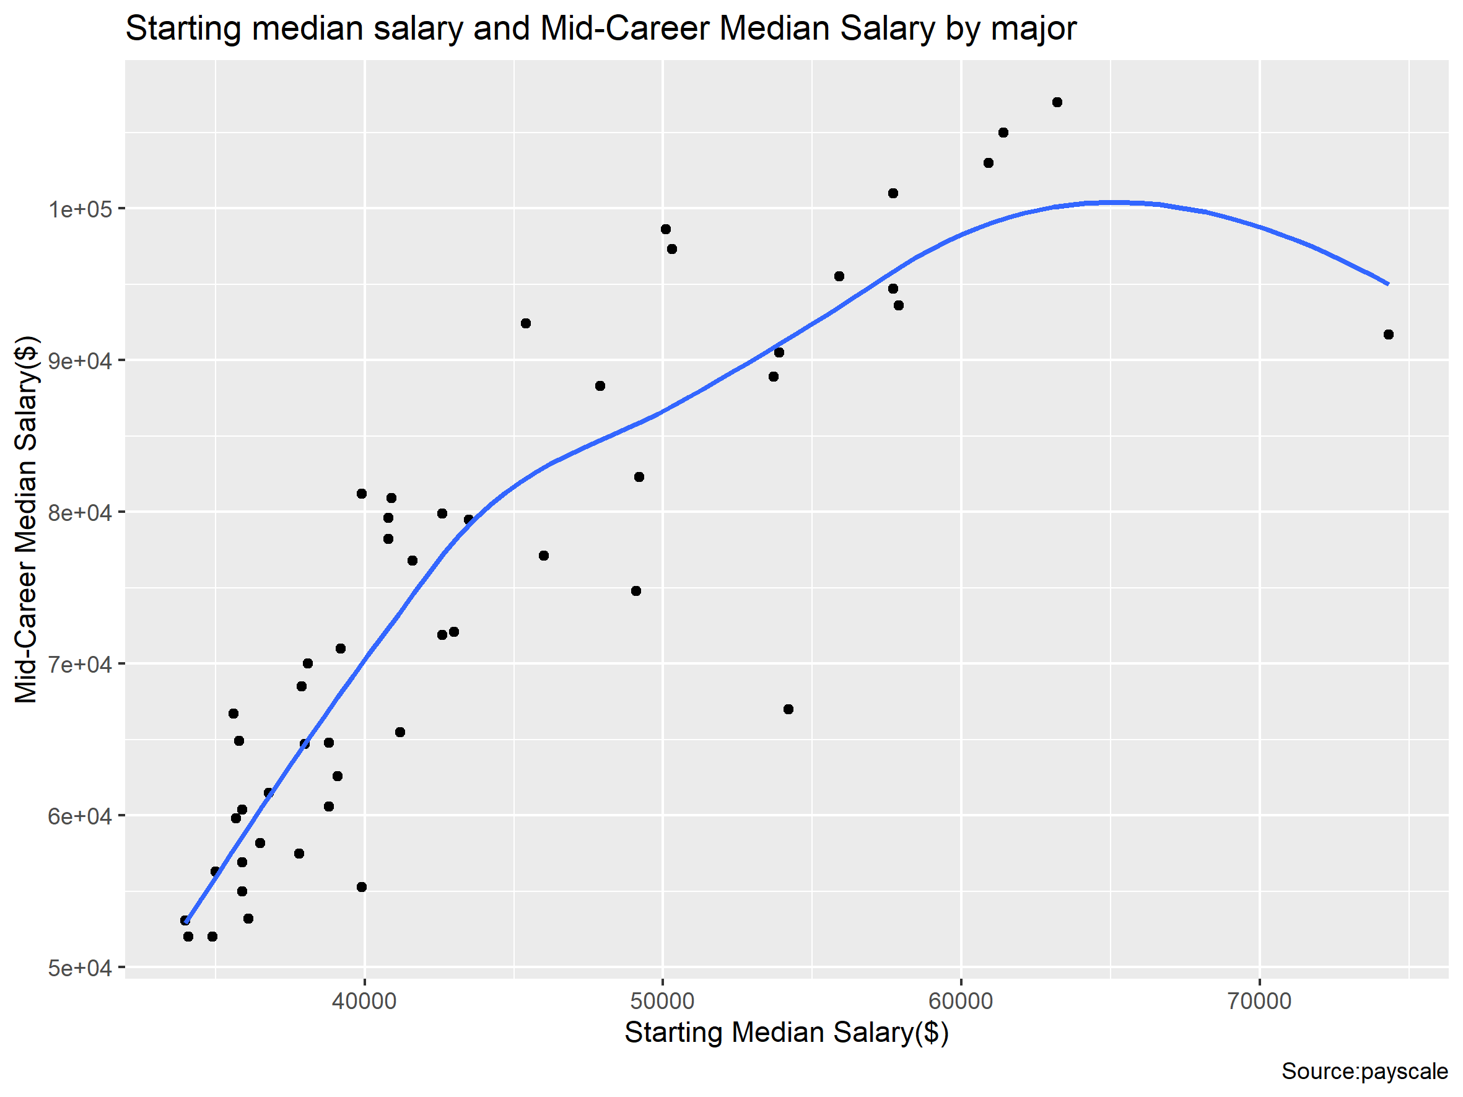
FIGURE: relationship between starting salary and mid-career salary （ Positive correlation ）

Slide 5
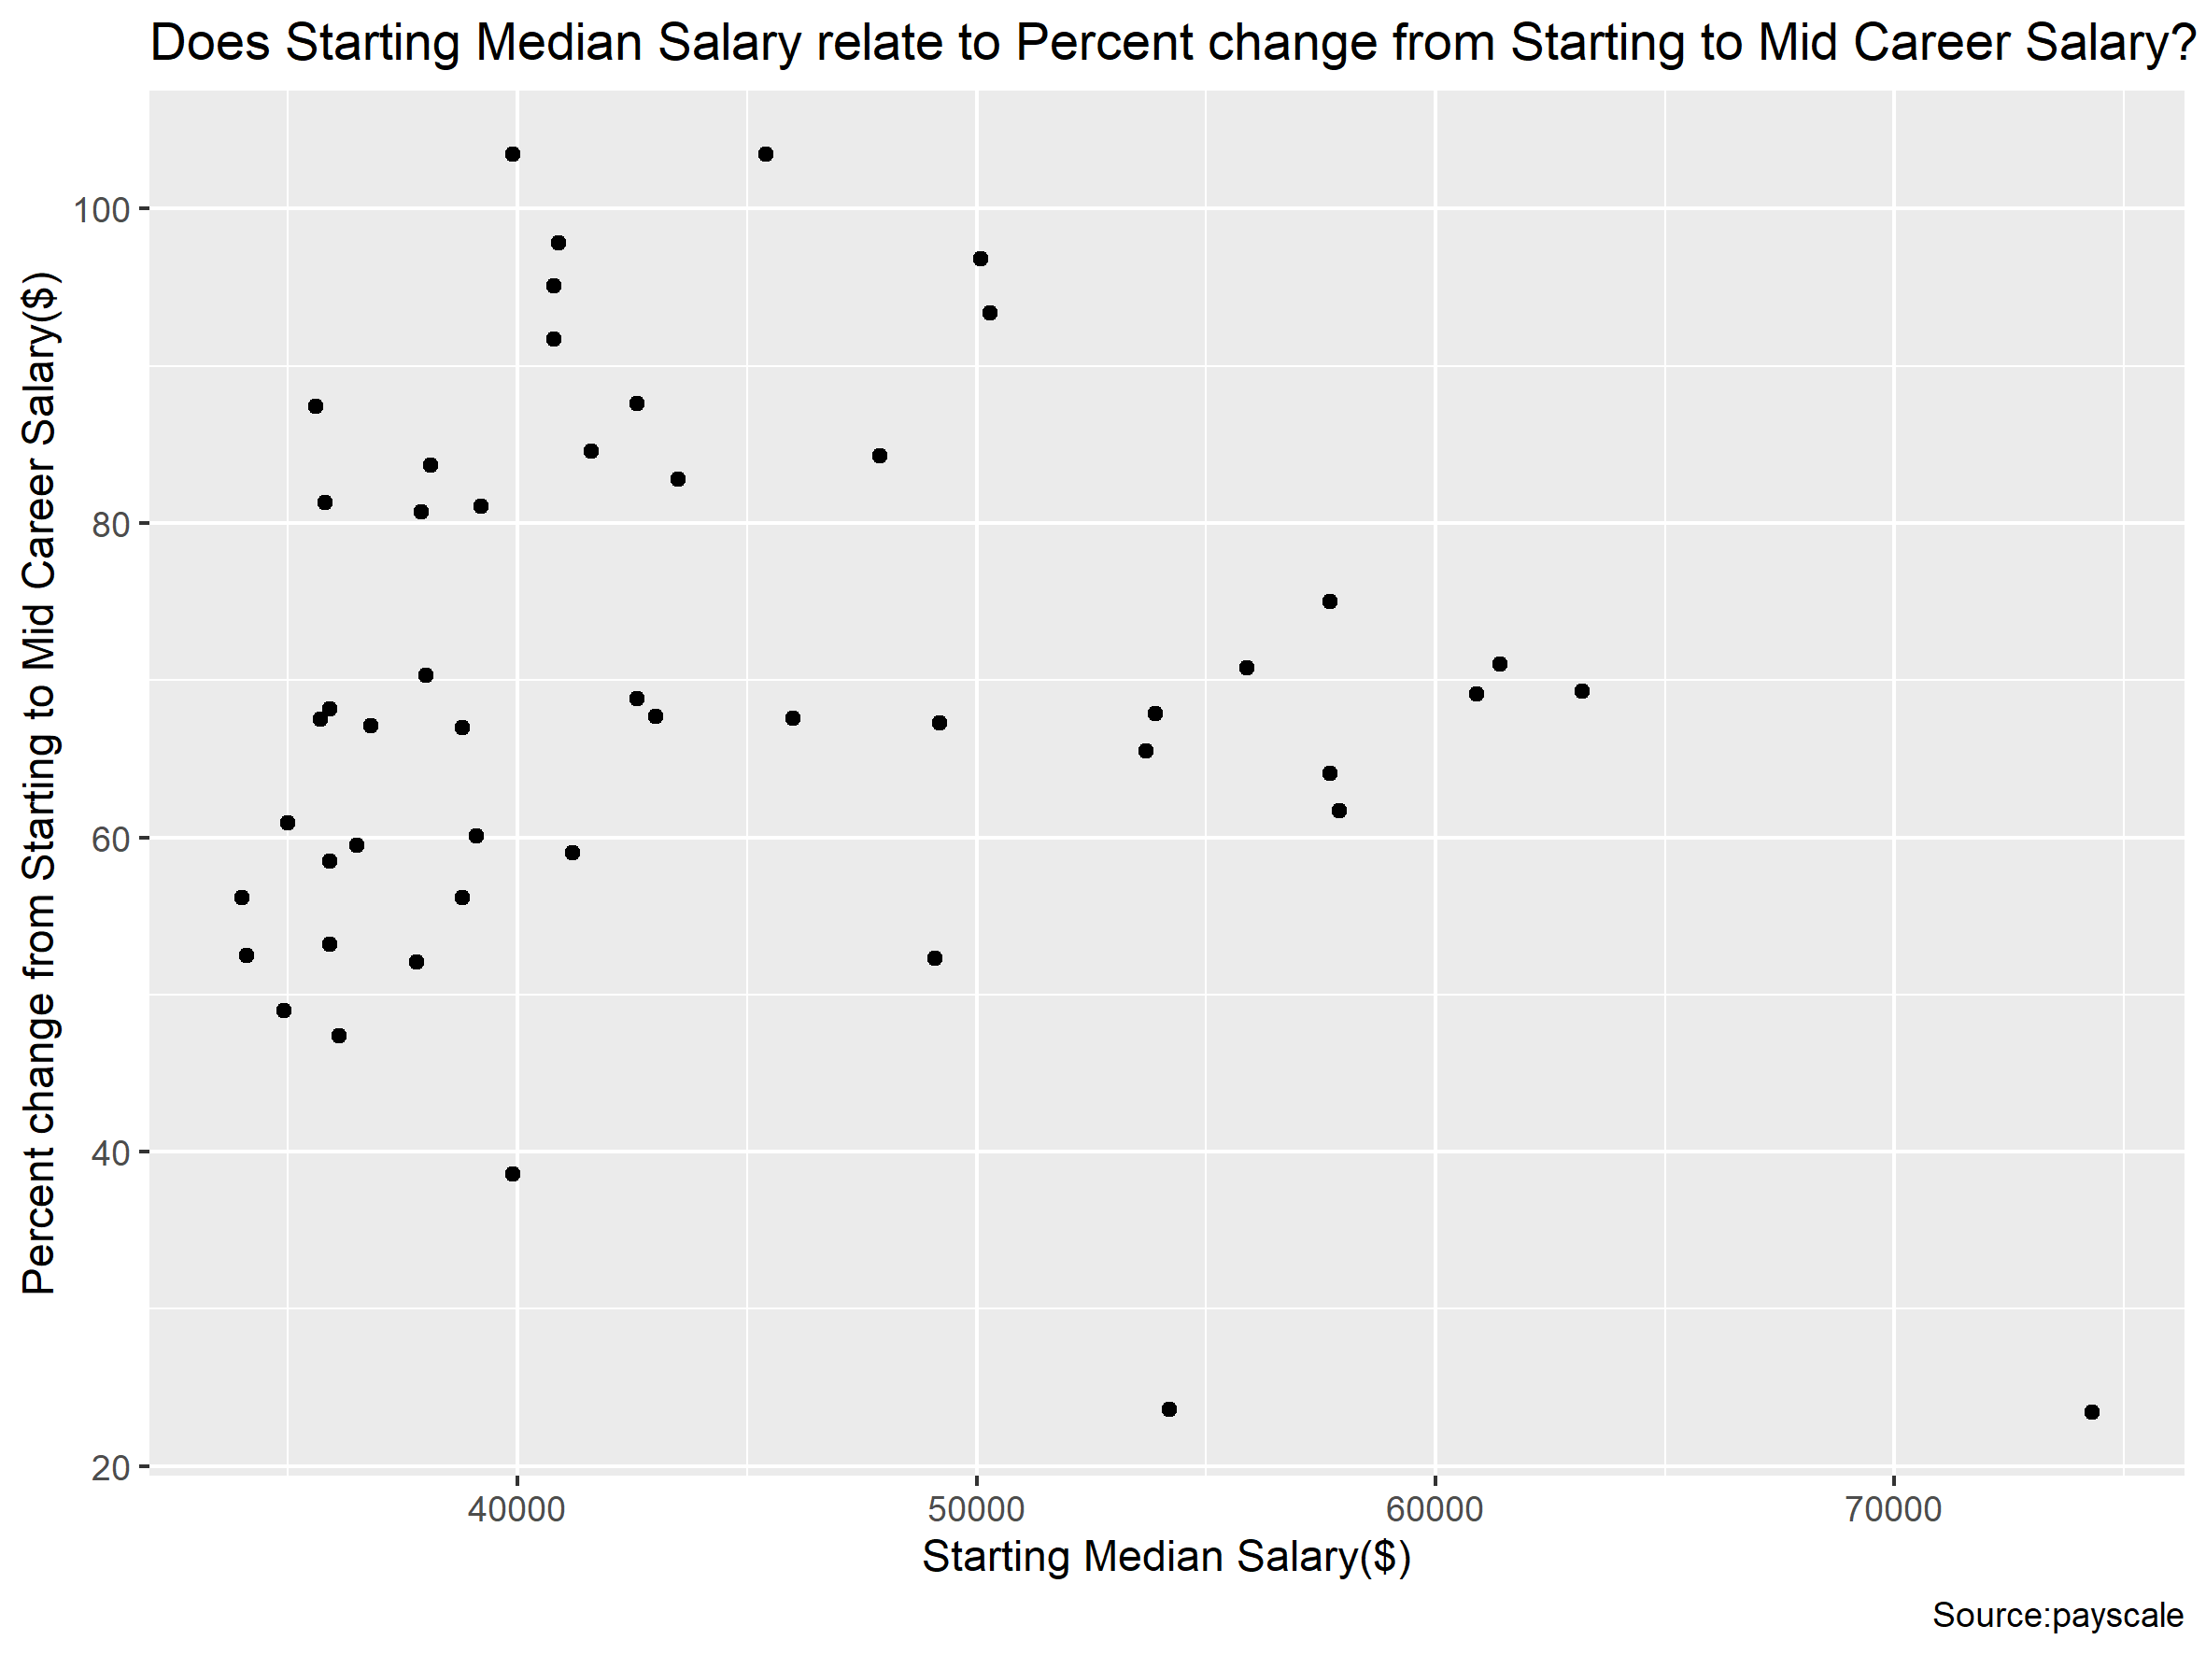
FIGURE: relationship between starting salaries and further wage growth（No significant correlation）

Slide 6
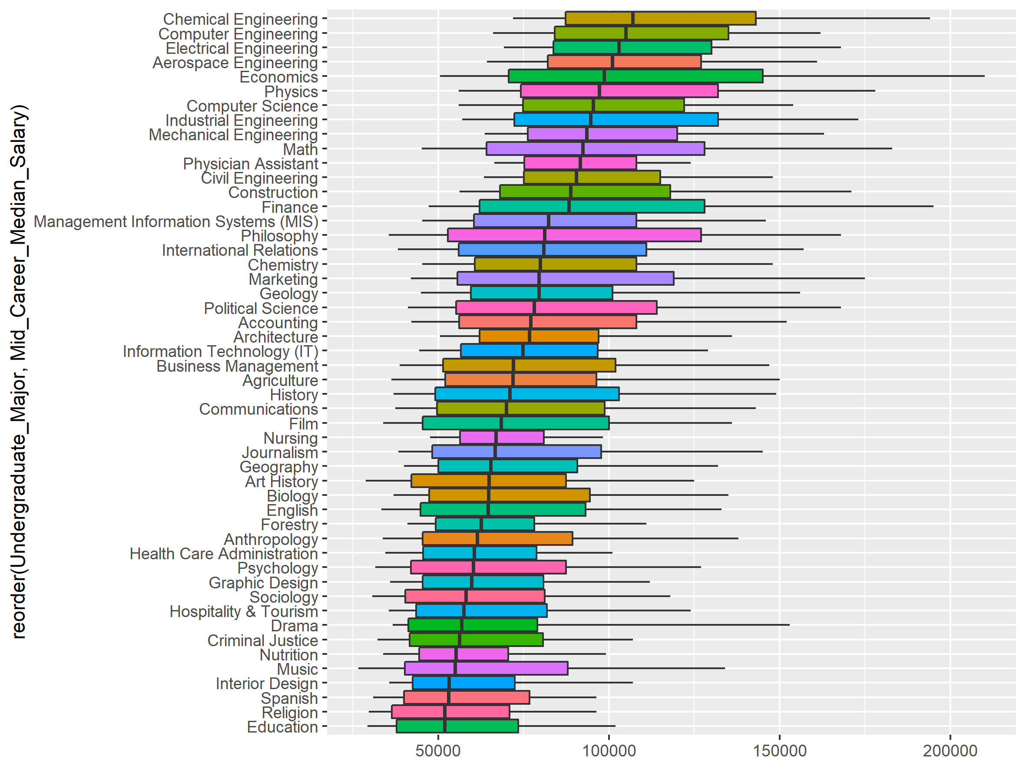
FIGURE: The median mid-career salaries of different major
The top five majors：
Chemical Engineering
Computer Engineering
Electrical Engineering
Aerospace Engineering
Economics （large variation）
The major with the lowest variance:
Nutrition
Nursing
(Choosing to study engineering is a smart choice for long-term earning potential)

Slide 7
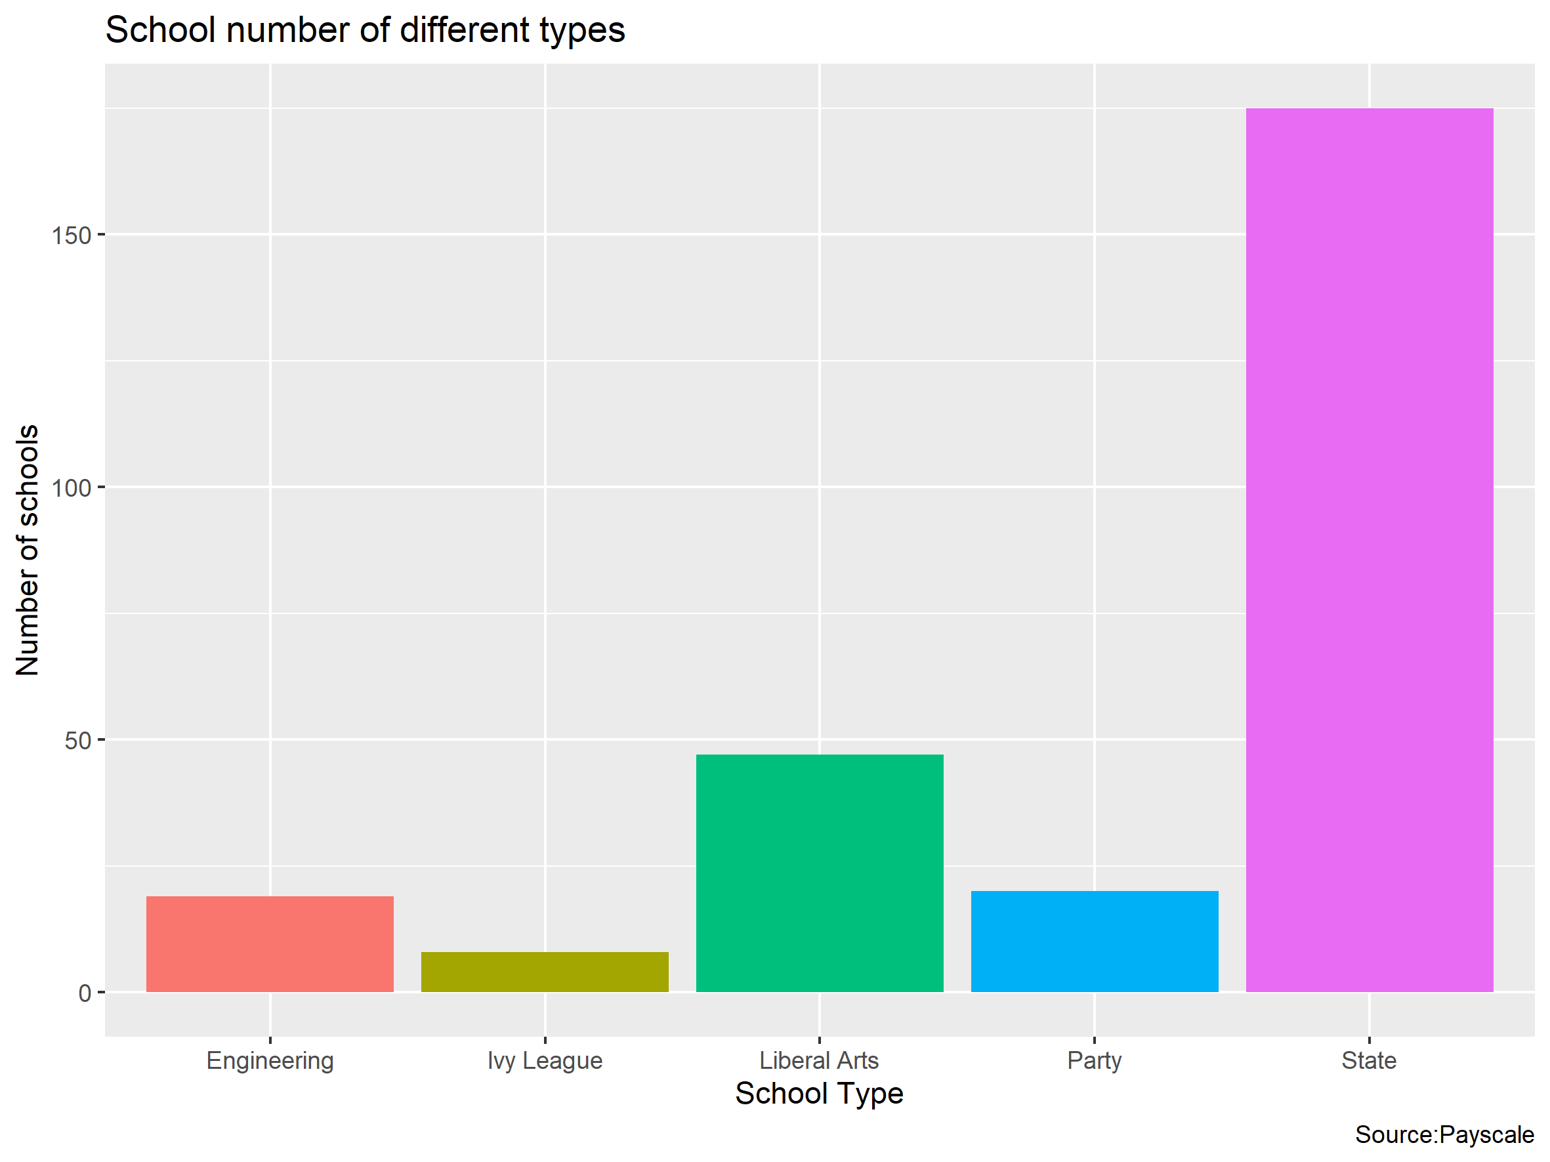
FIGURE: The number of schools of different types in our sample

Slide 8
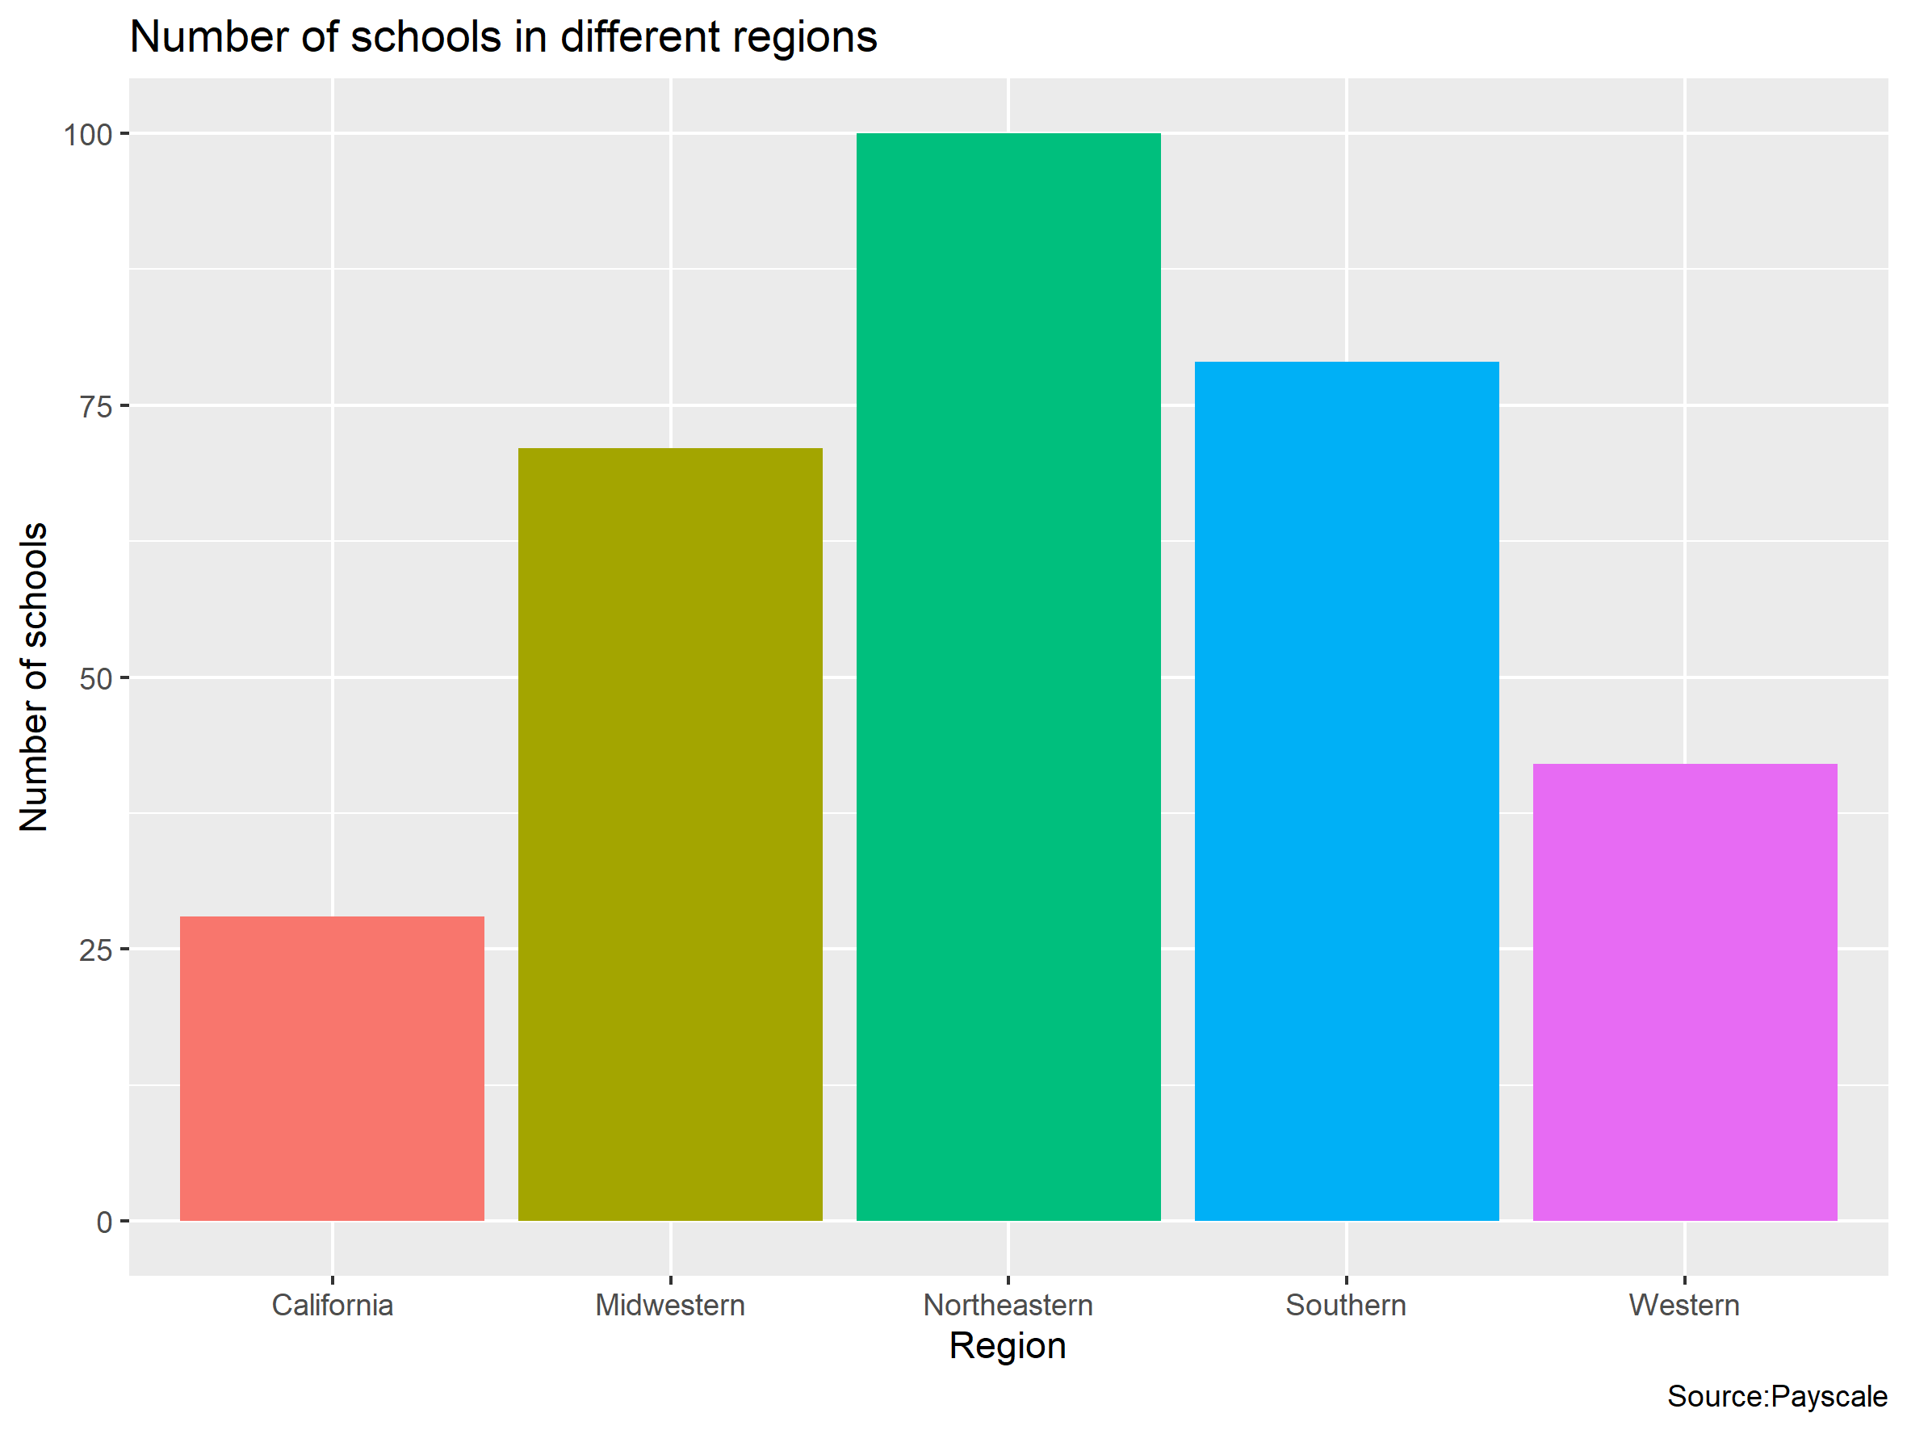
FIGURE: The number of schools in different regions in our sample

Slide 9
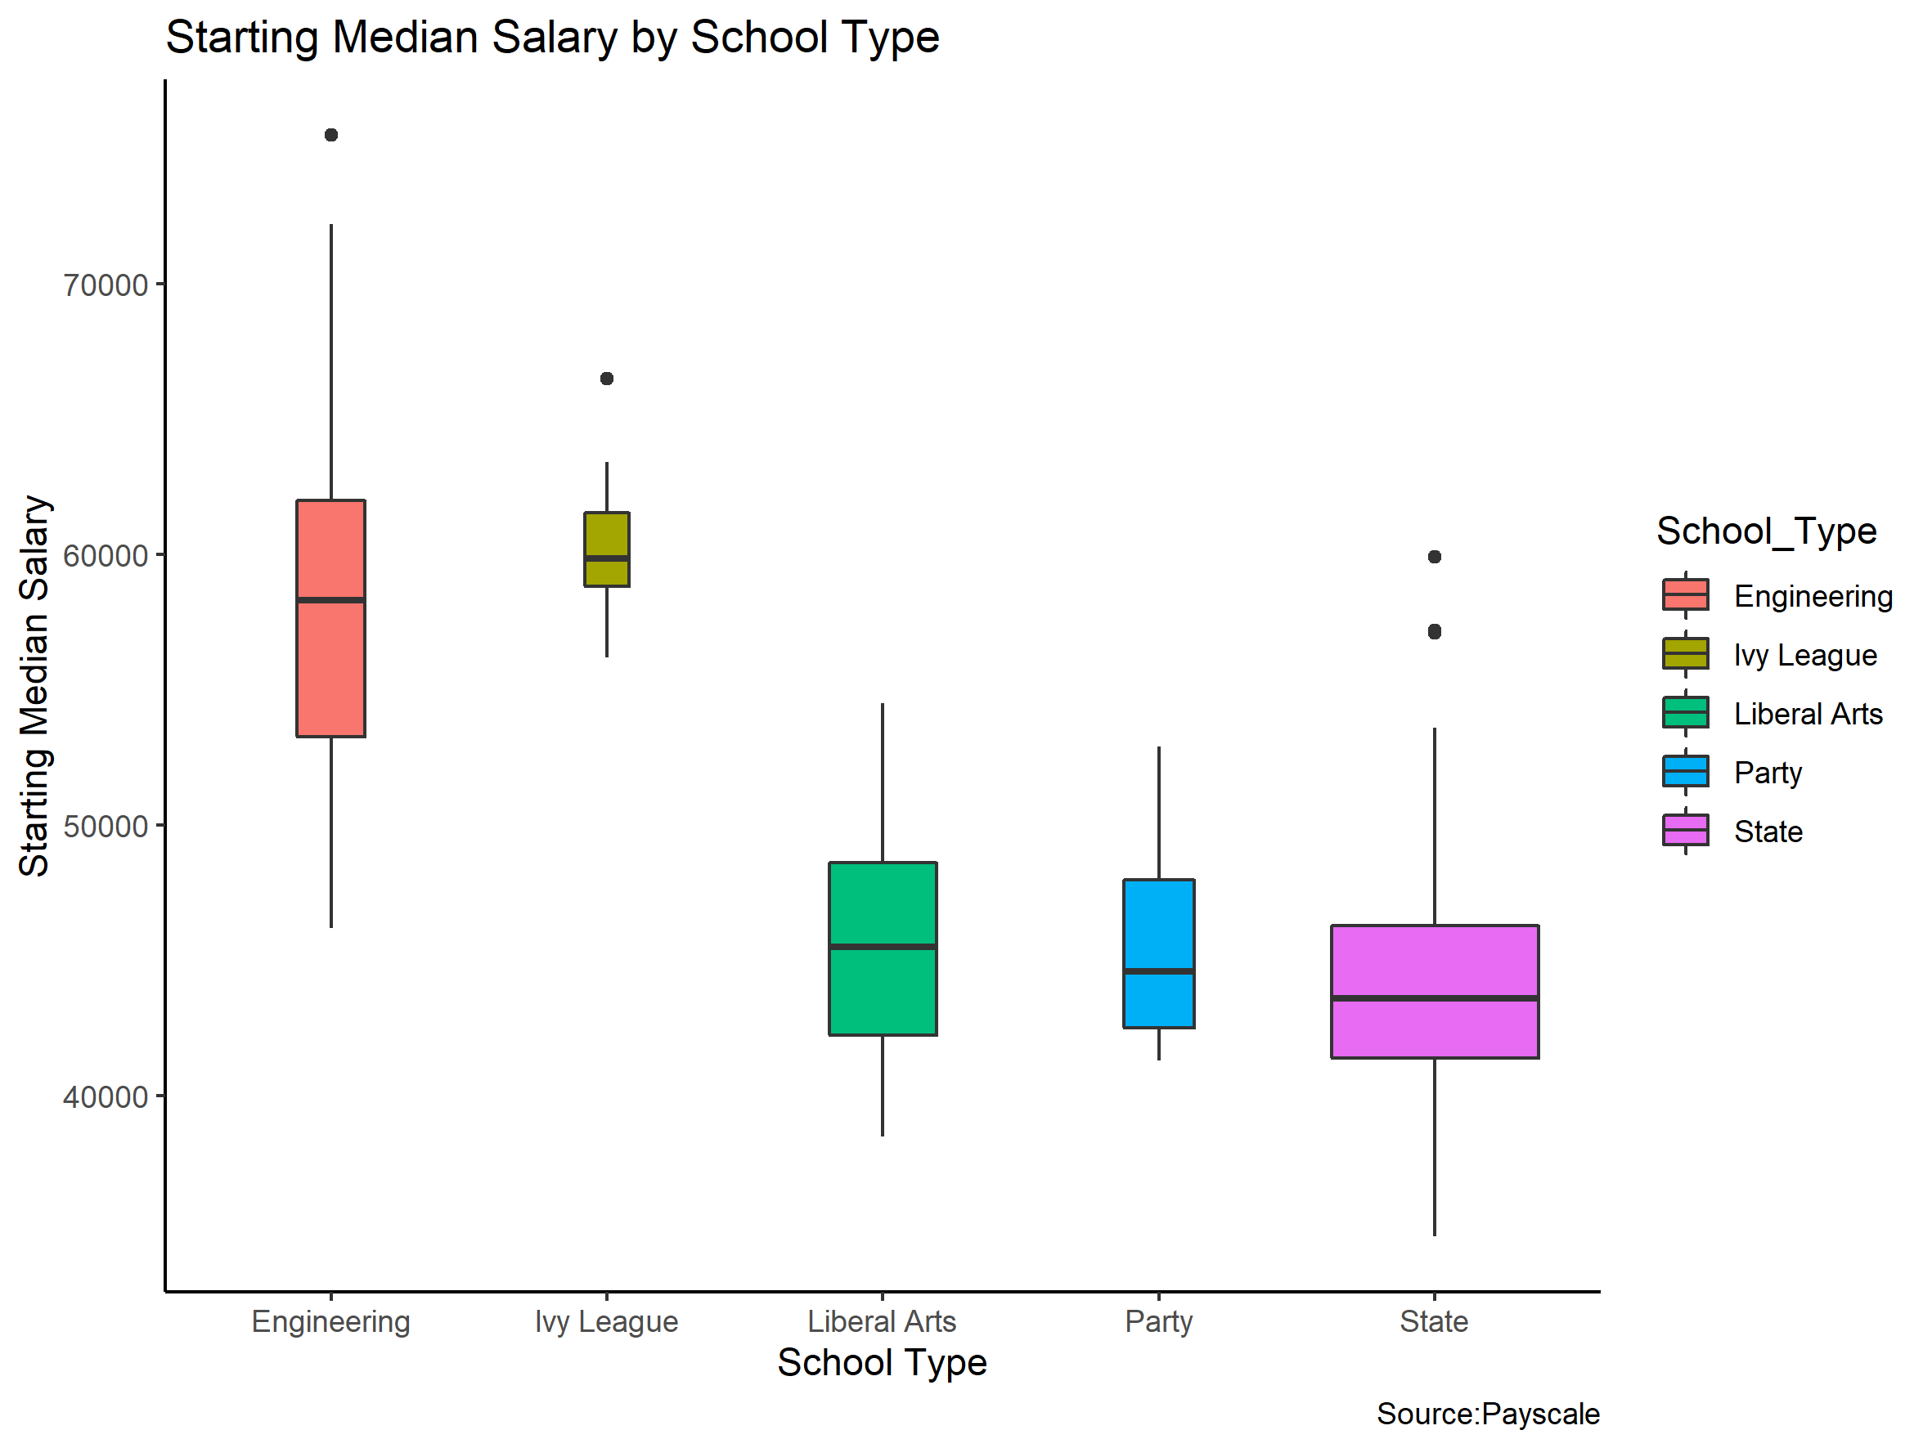
FIGURE: Starting salaries for different types of schools
Starting salary for Ivy Leaguers is the highest one.
One reason why Ivy Leaguers outpace their peers may be that they tend to choose roles where they‘re either managing or providing advice.
By contrast, state-school graduates gravitate toward individual contributor and support roles.

Slide 10
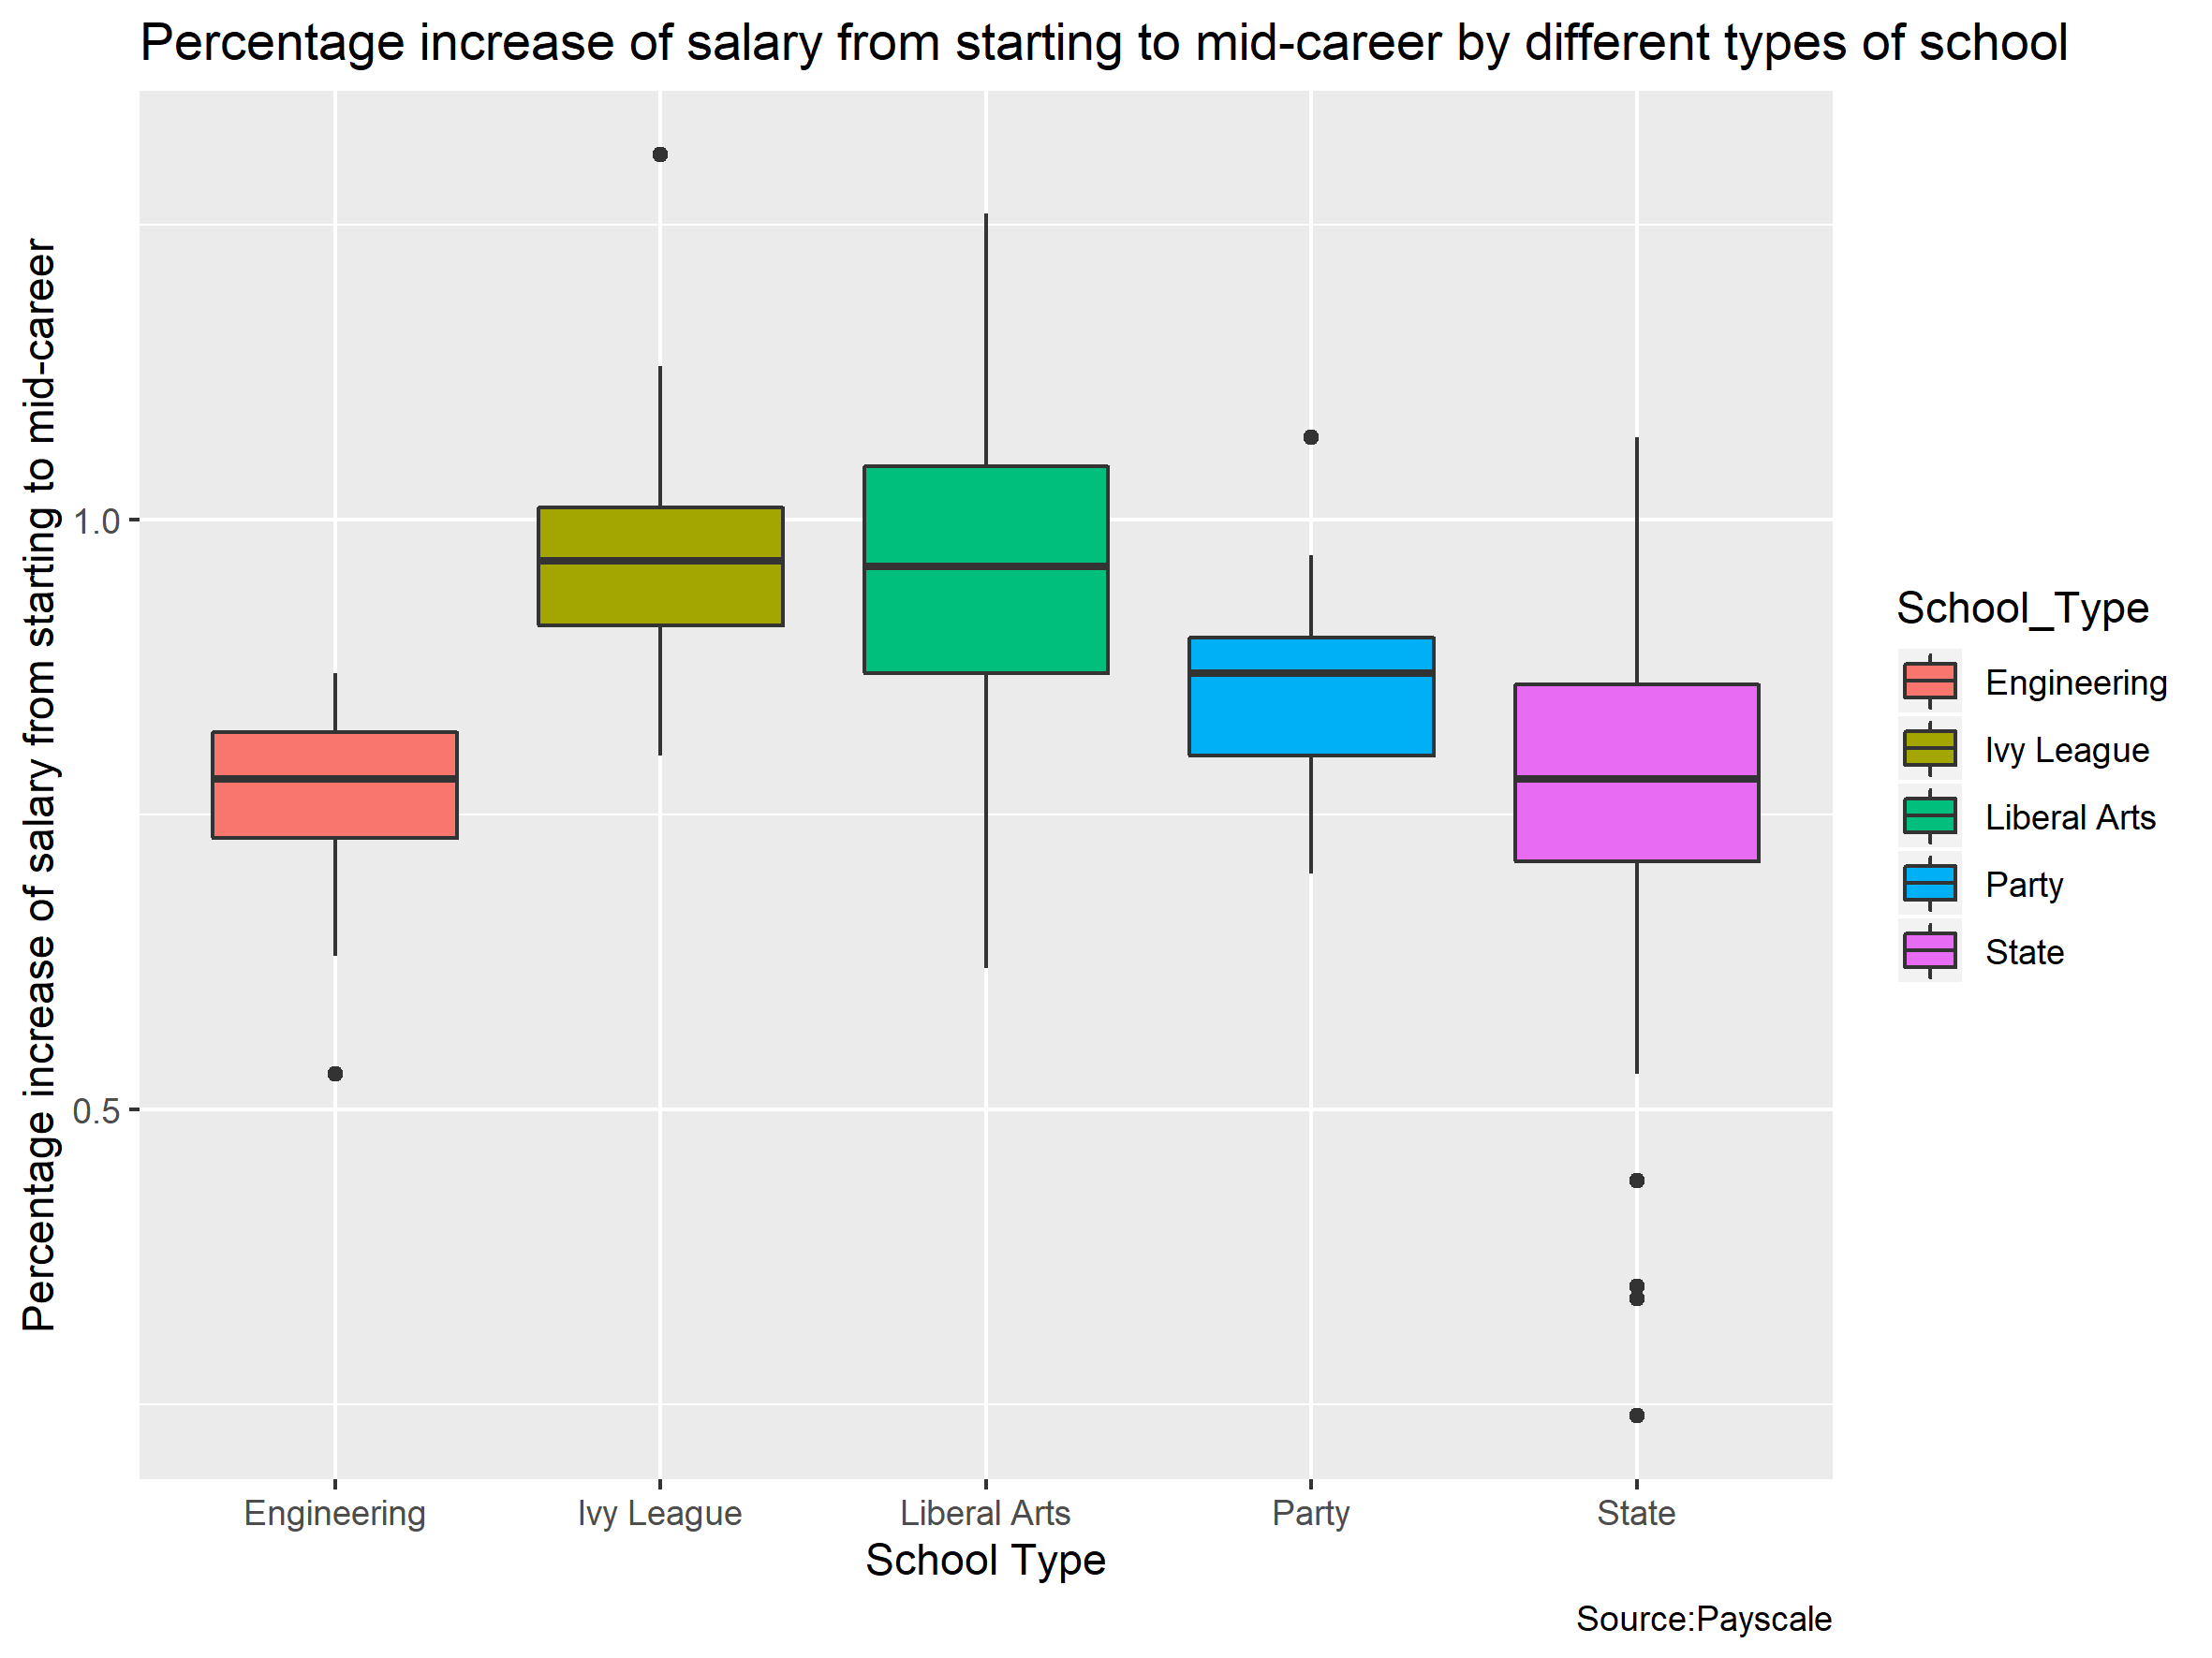
FIGURE: how much salaries increased over time for different types of schools
At the bottom:
Engineering-school grads, who earn the highest starting salaries
At the top:
Liberal-arts-school graduates see their median total compensation grow by 95% after about 10 years
At the middle:
graduates of "party schools" (as defined by the 2008 Princeton Review College Guide) aren't that far behind, with their incomes increasing about 85%

Slide 11
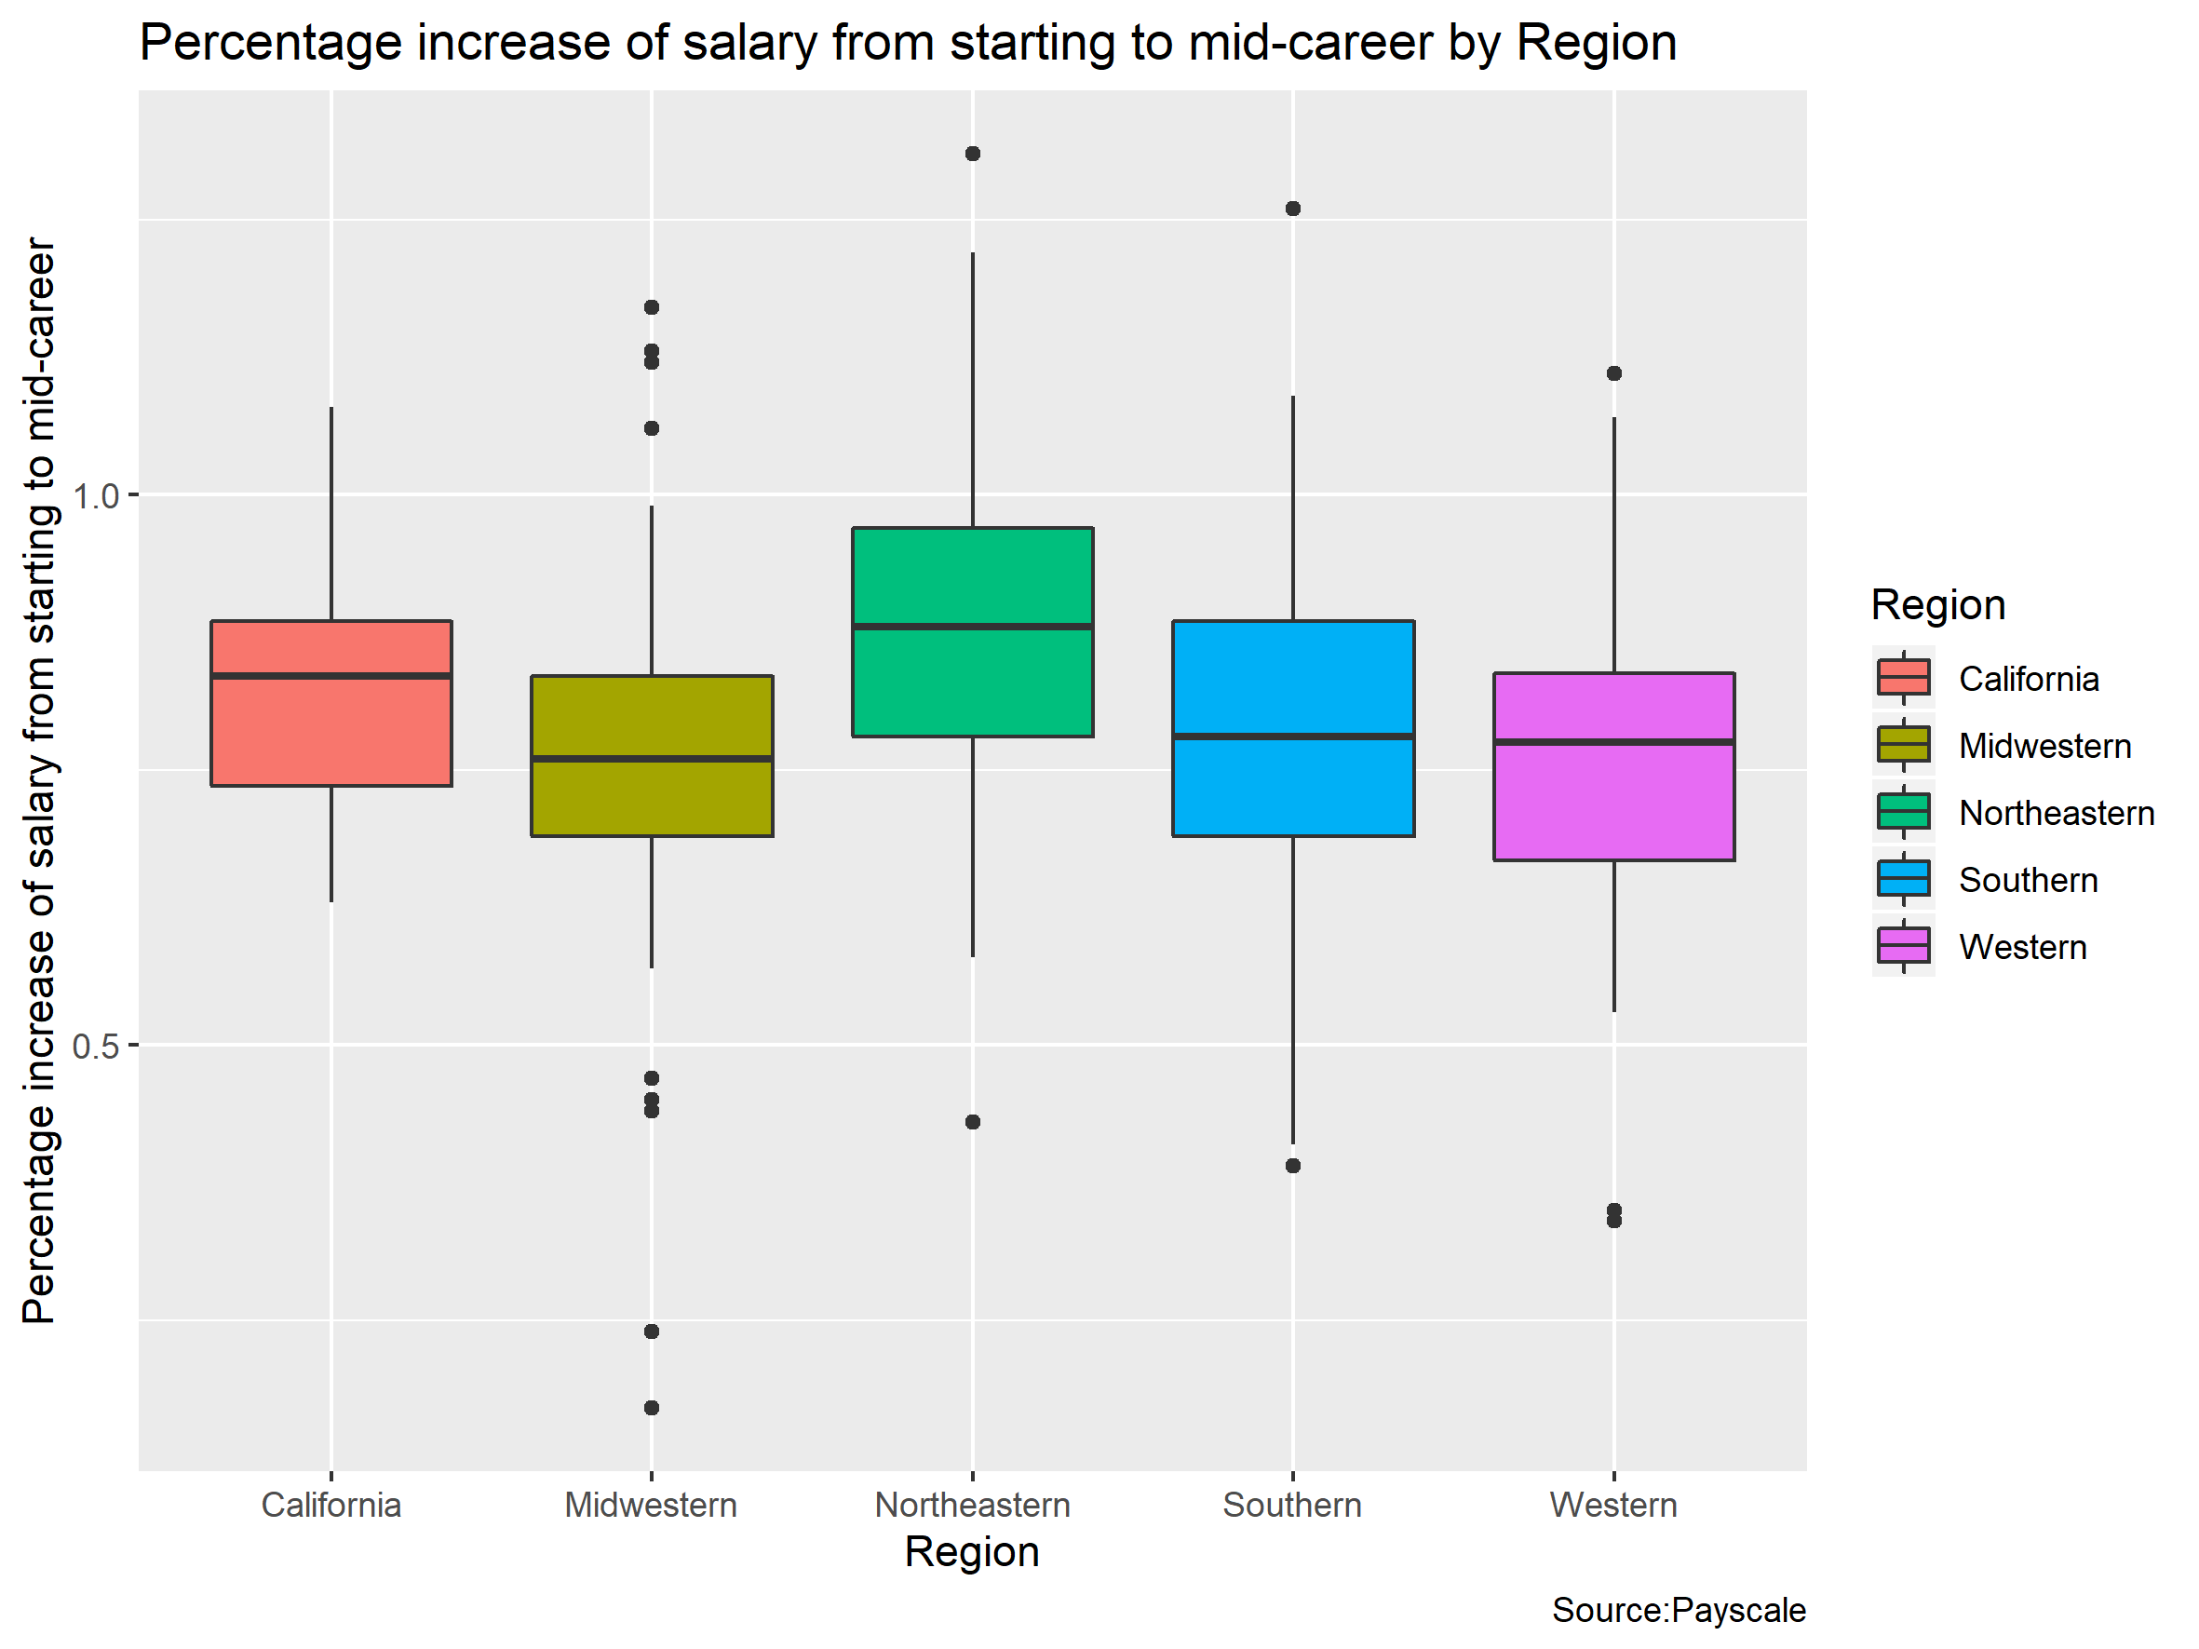
FIGURE: The growth rates of schools in different region
Compare to the last figure, there is no significant difference in increase of salary among different regions.
So the difference in growth rates is more relevant to the school type than to the school region.

Slide 12
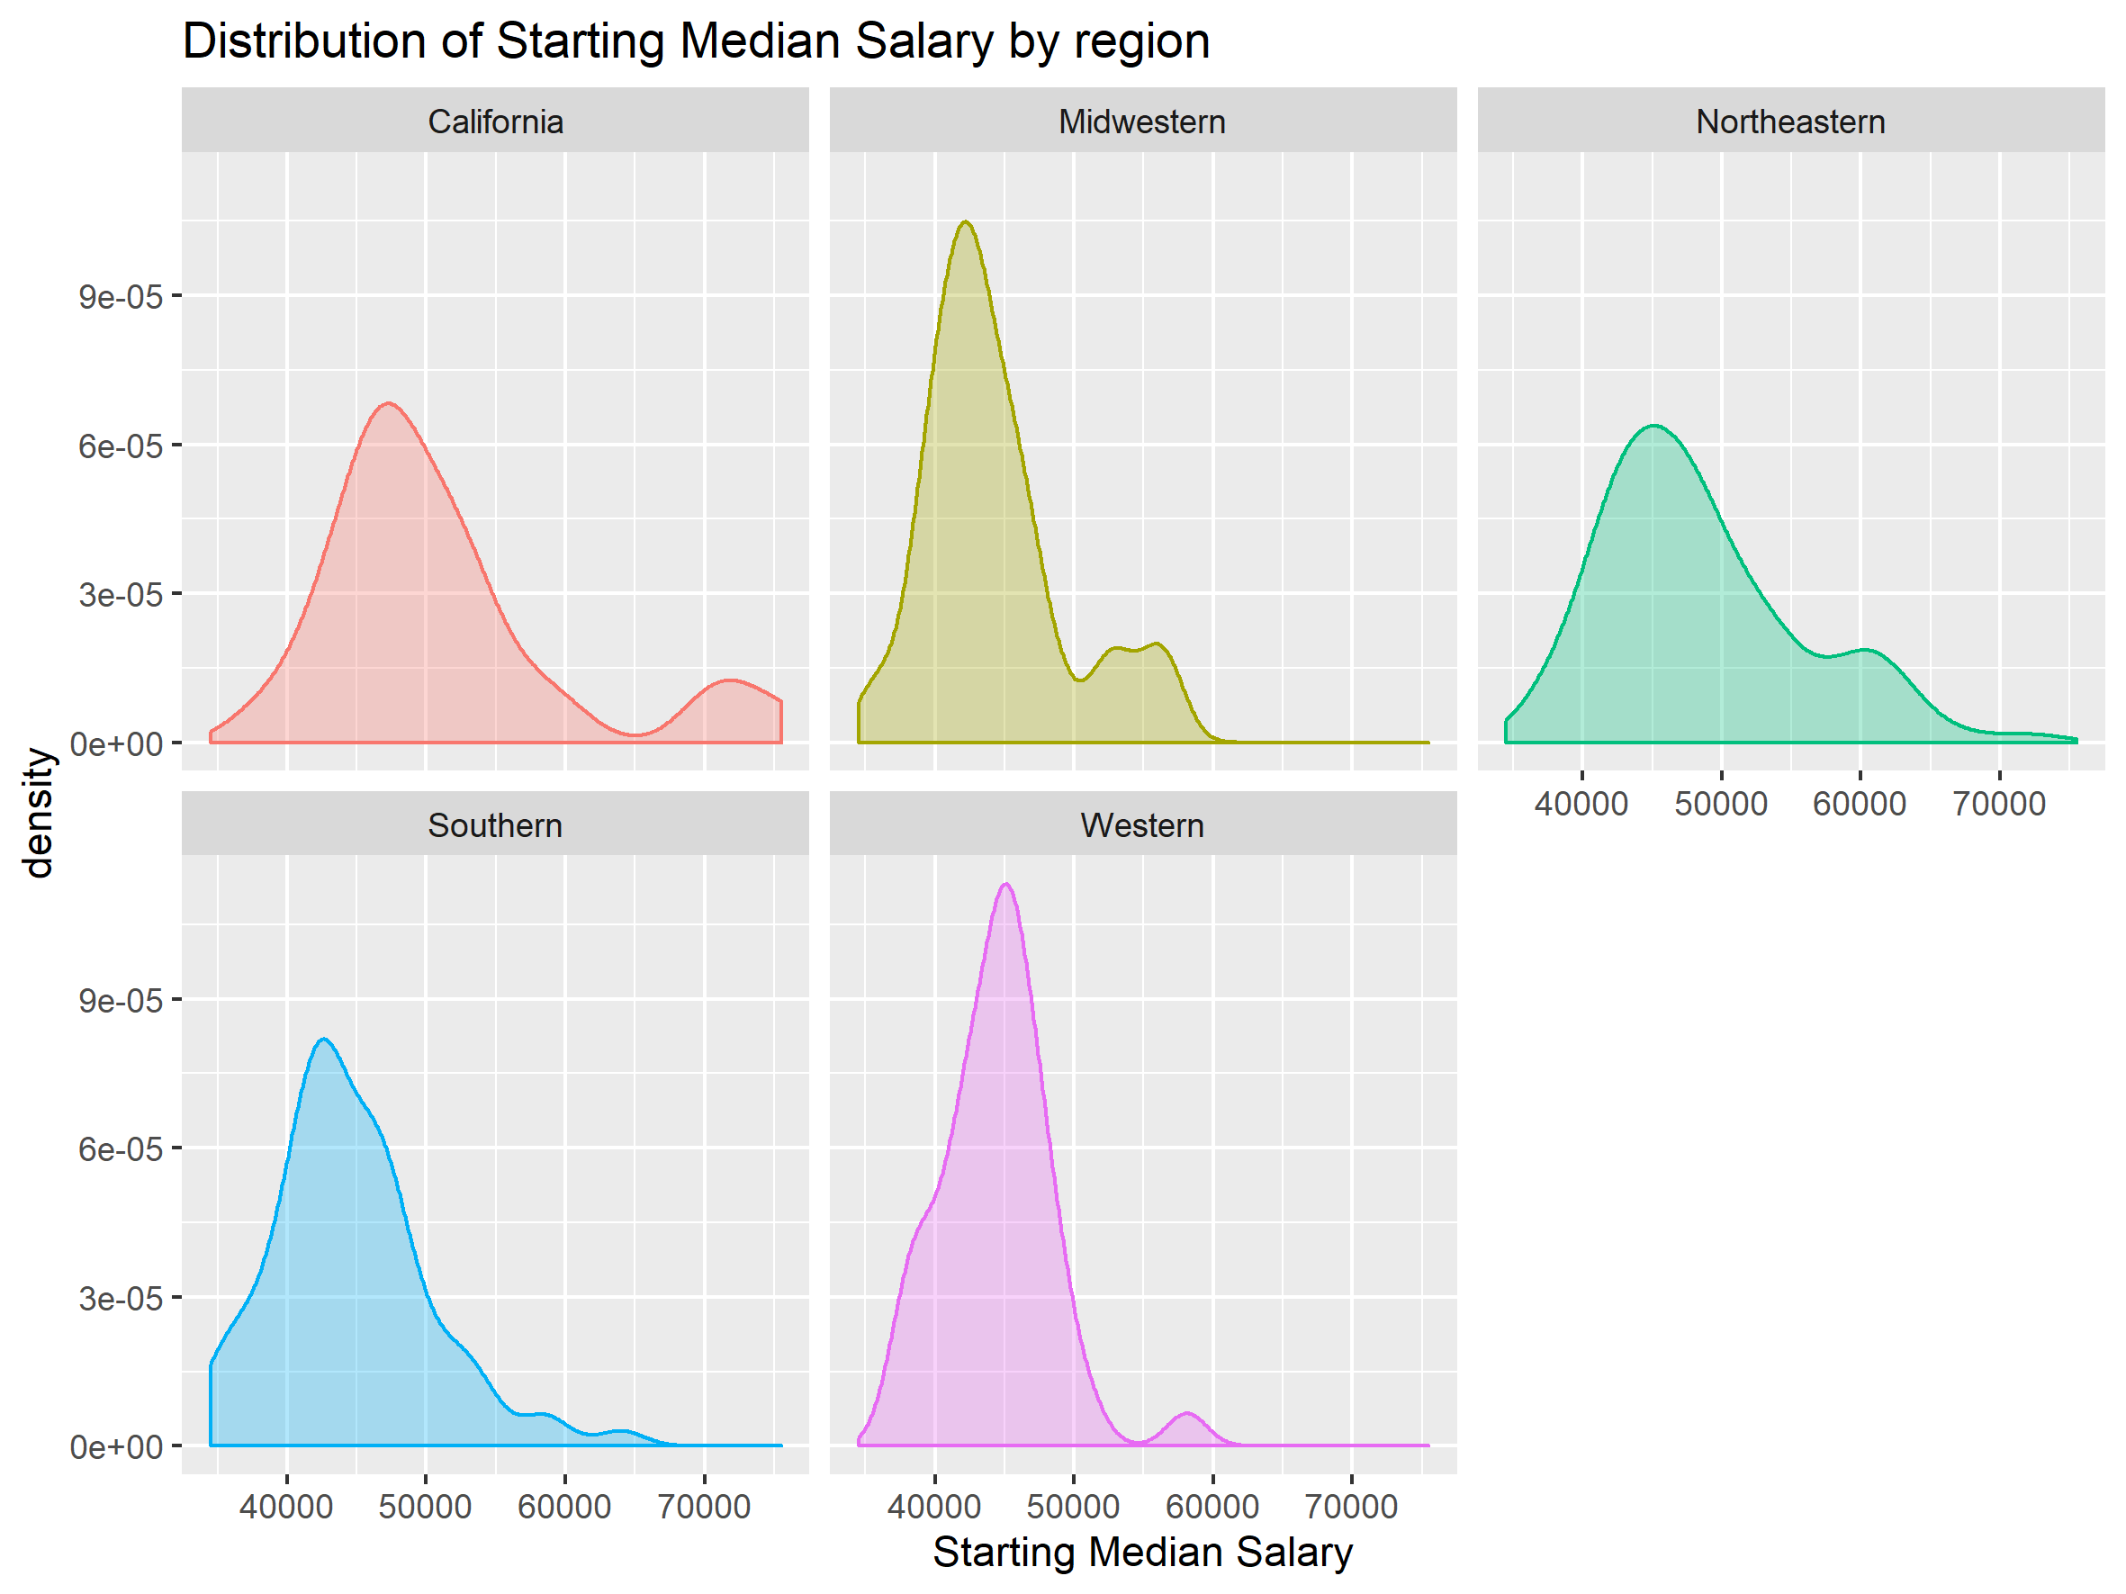
FIGURE: The distribution of starting median salary by region

Slide 13
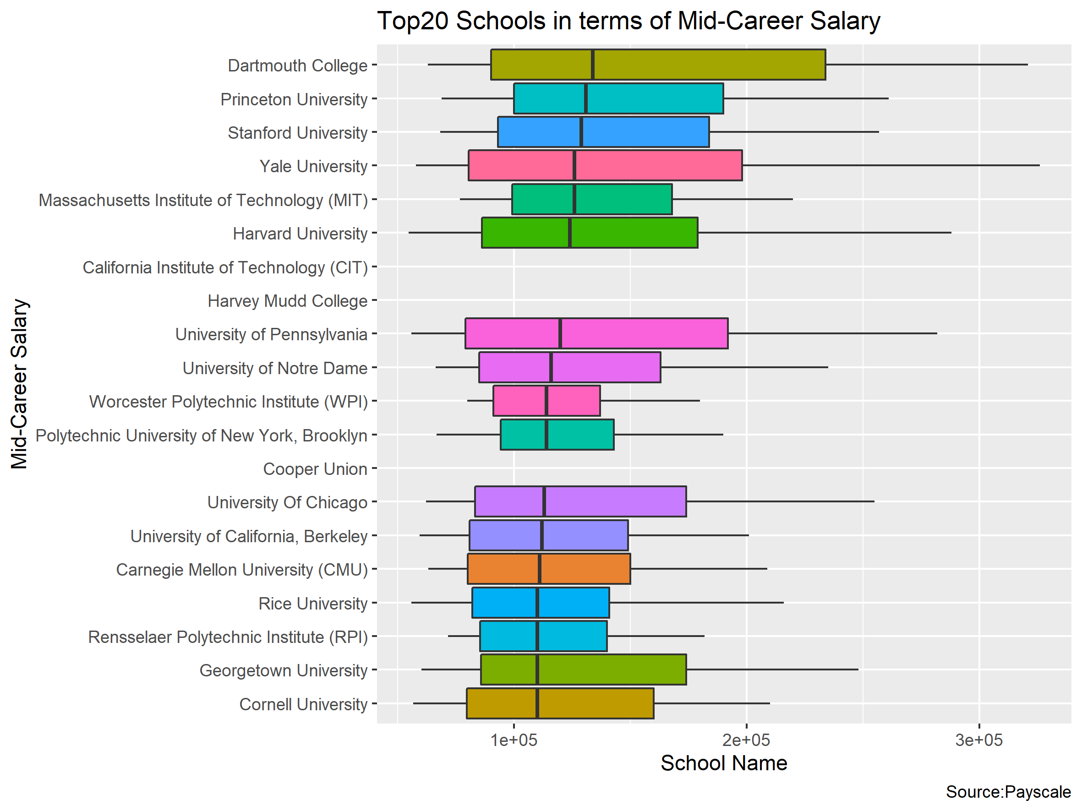
FIGURE: Which school pays off the most?
According to the survey, graduates of Dartmouth College, an Ivy League college, earn the highest median salary -- $134,000.

Slide 14
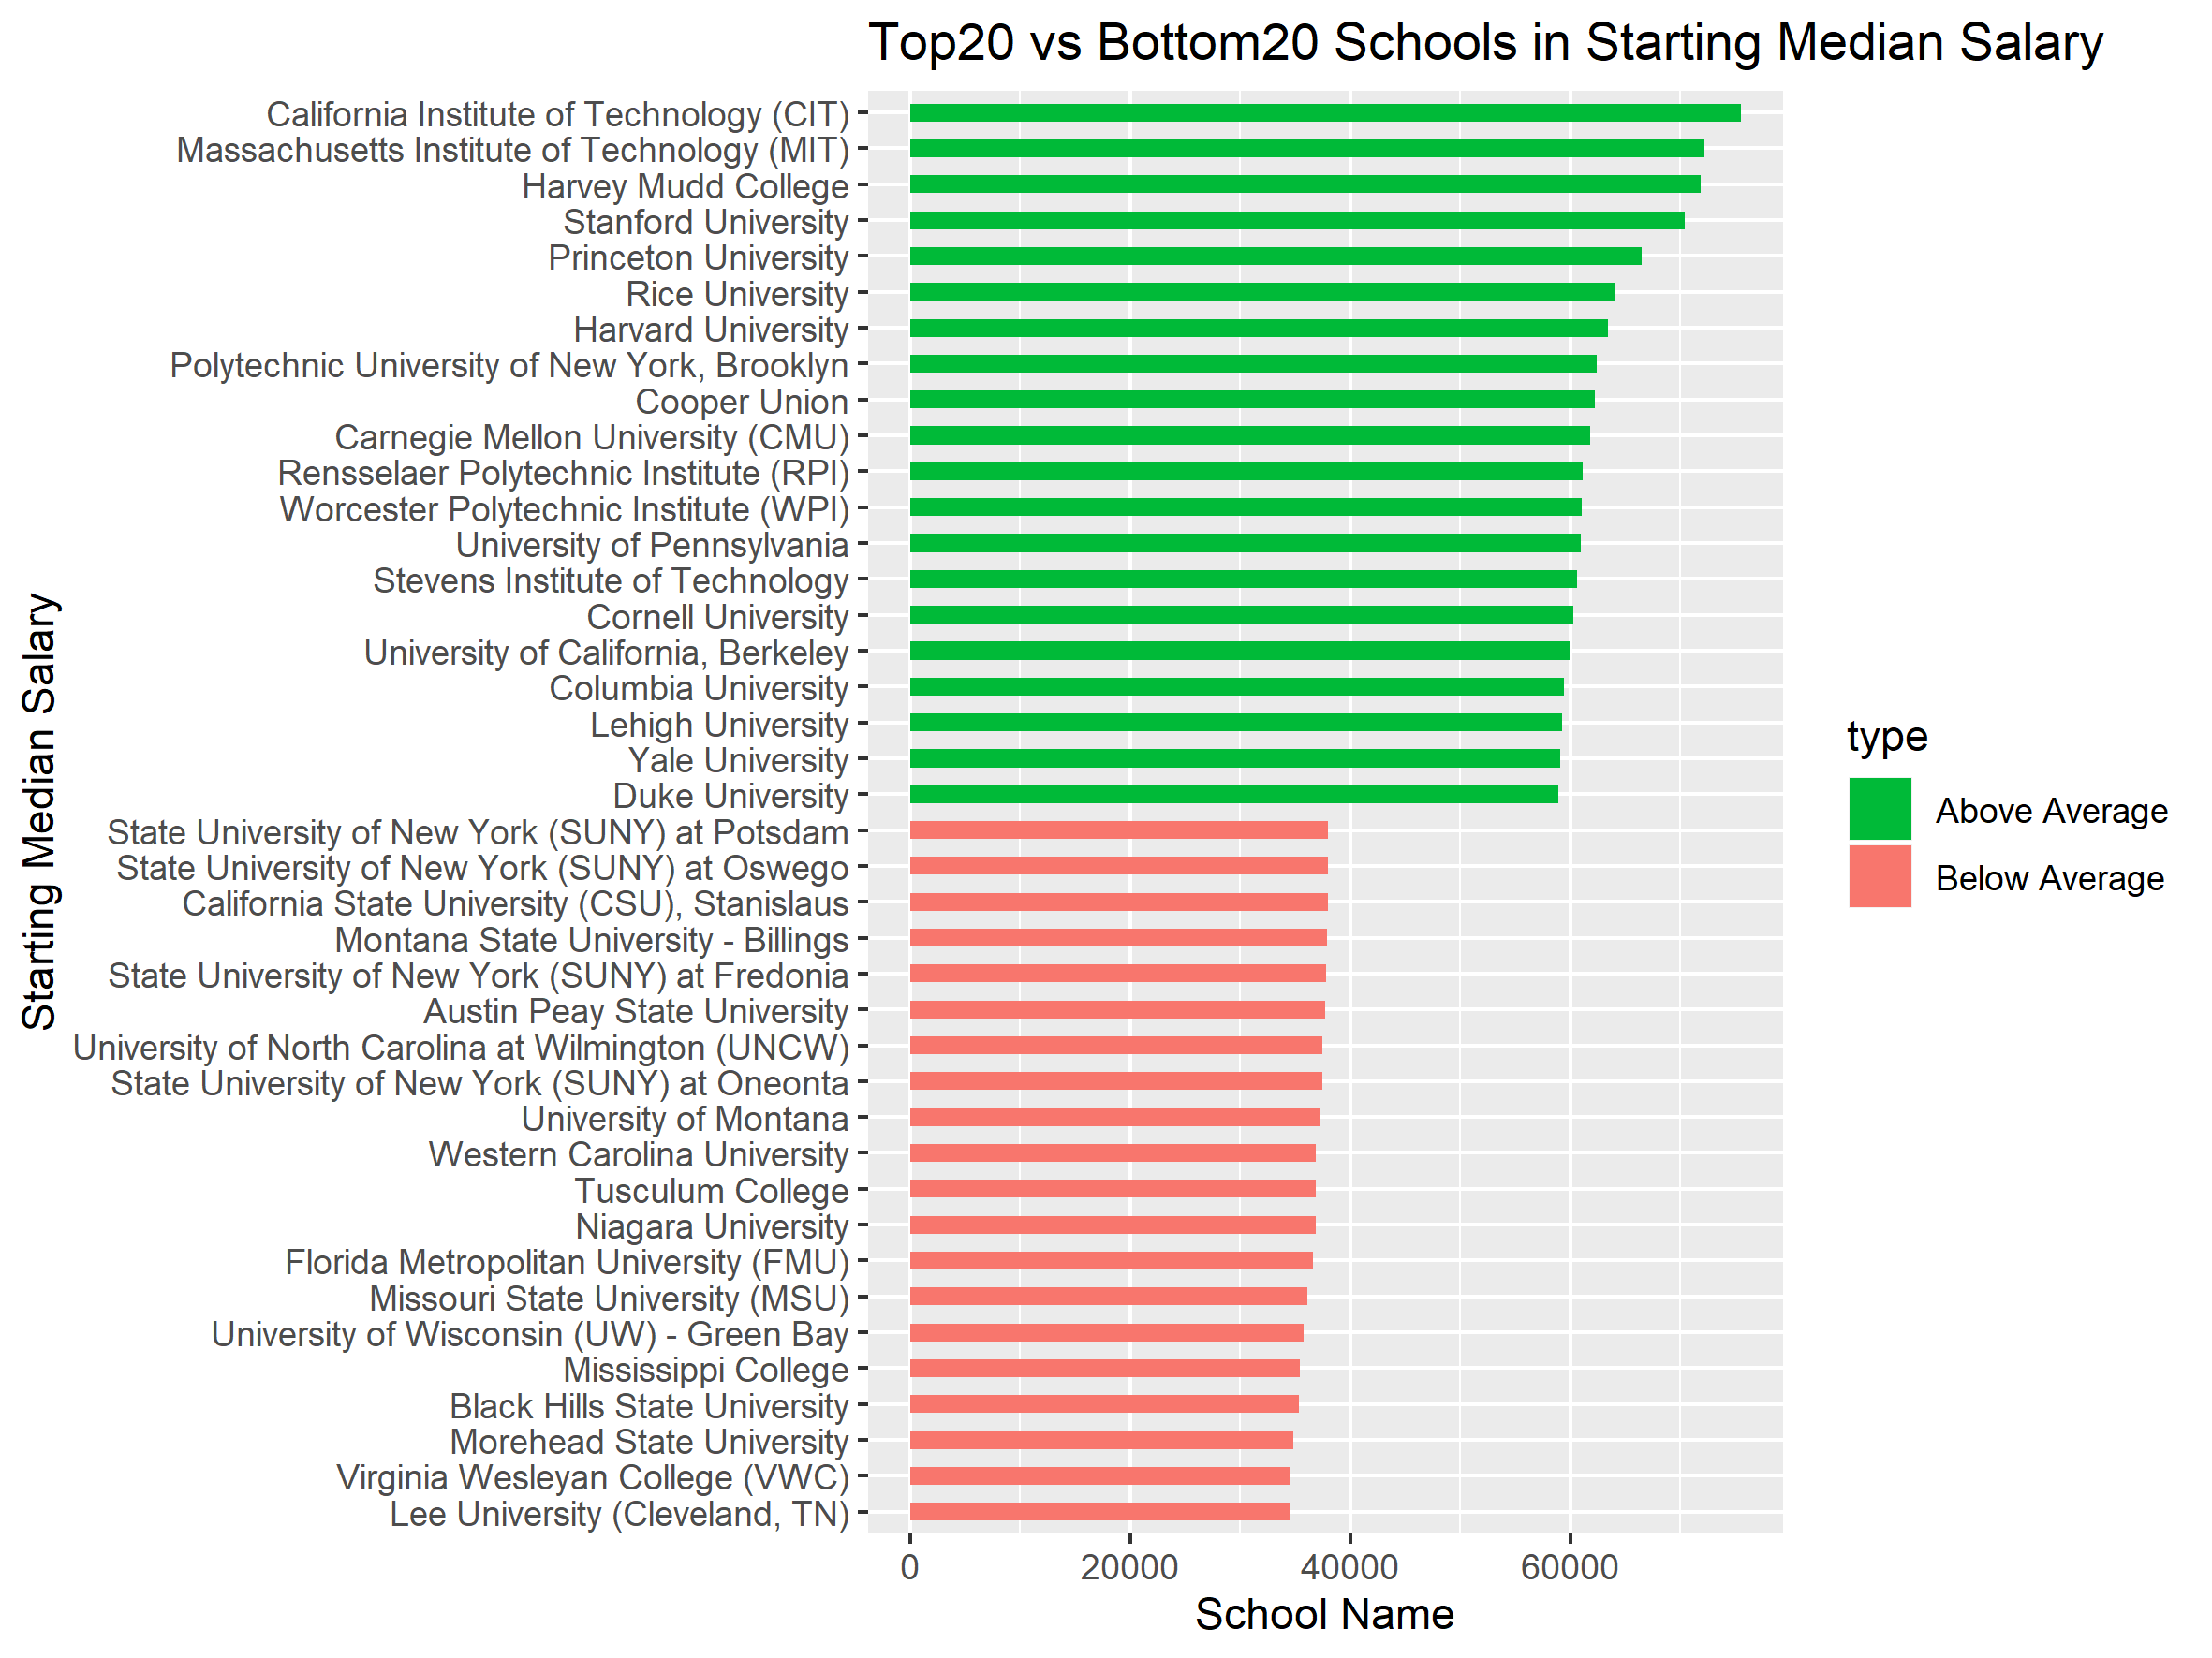
FIGURE: Top 20 and bottom 20 schools for starting salaries

Slide 15
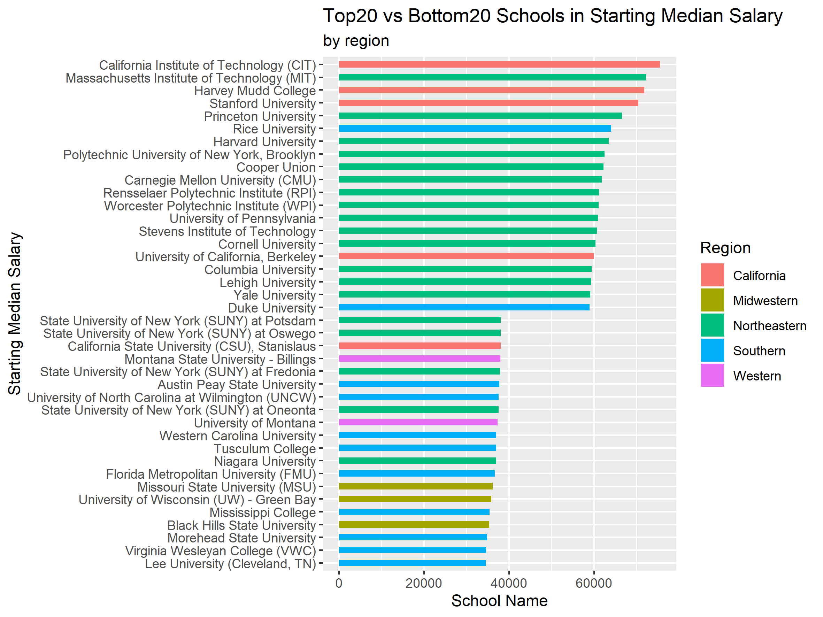
FIGURE: Region composition of top20 and bottom20 schools

Slide 16
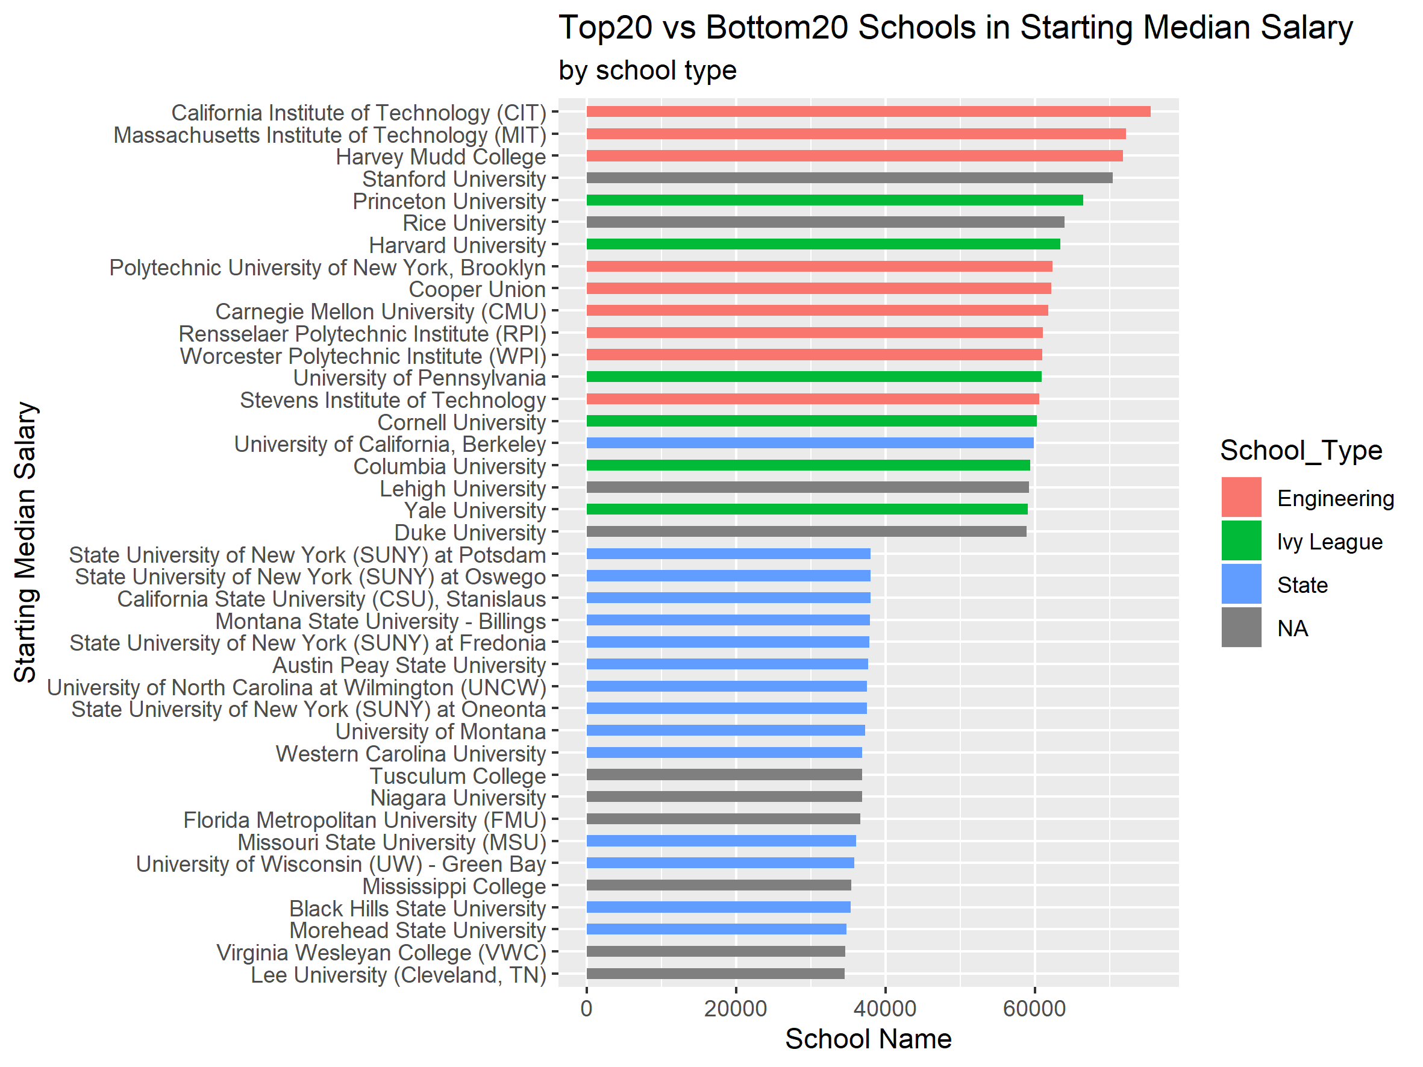
FIGURE: Type composition of top20 and bottom 20 schools

Slide 17
CONCLUSION
Choosing to study majors related to engineering is a smart choice for long-term earning potential.
Ivy Leaguers have both higher starting salaries and wage increase rate over time. Try to get into a better college and you will have more chances to succeed in your career.
The salary of students who major in liberal arts or study in liberal-arts-school is influenced by more factors, and individual differences are even greater.
Graduates from state universities tend to be paid less.
Wage growth has more to do with the type of school than the region.

